Slide 1
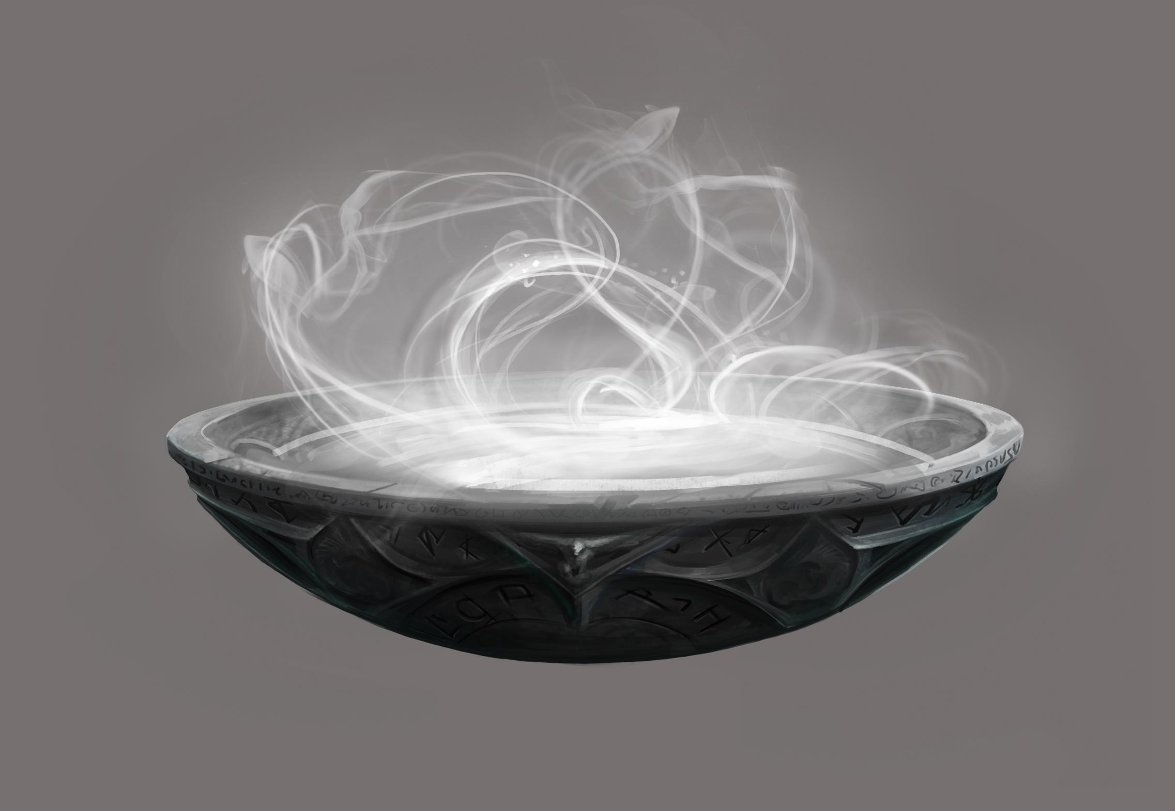
Paving the Bare Spots
To Build a Muggle Pensieve
Notes:
Start by explaining the title

Slide 2
Pensive + Sieve
Magical object for storing and sifting thoughts and memories
Notes:
Harry Potter reference

Slide 3


Muggle?
← Wizard
(Real magic powers)
Muggle →
(No real magic powers)
Notes:
Another Harry Potter reference

Slide 4

Pave bare spots?
Find what is
already working, make improvements and document to build a system that fits naturally
Notes:
Story of a college that didn’t build any sidewalks at first; a year later paved the tracks that were worn into the lawns to make walkways that followed where people were already walking
As a design philosophy: take what is already working, fix problematic areas, make improvements, and codify it into a process
Contrast with imposing an artificial system

Slide 5
Collecting my thoughts
⌨️
The trouble with
writing things down
Notes:
What is this talk actually about? I want to share how I record, collect, and (occasionally) organize ideas, notes, scripts, and other things.

Slide 6
📋
Where should this go?
📂
📝
📄
⌨️
?
📂
📂
📃
🗒
Where did I put that??
Notes:
Finding the “right” place and making “publishable” were barriers to writing something at all
“The best is the enemy of the good” - Italian proverb
Often no “right” place, lead to scattered notes files
Finding where I might have written something months ago lead to much rummaging

Slide 7
One notes file
📓
New sections go at the top
One place to write
One place to search
Archaeological layers
Write now, right place later
Notes.md
Notes:
Reduce friction for writing something - store those thoughts and memories, sift through them later - thus “pensieve”
Make it easy to find things - no more rummaging
So easy and so flexible, I really do much of my thinking here now

Slide 8

One repository
📁
Backup, versioning, organization
Private repo
Share useful stuff - even before it's "ready"
Transparency
Keep it a sandbox - rough is OK
Start to organize, but don’t stress
bjh-edx-pensieve
Notes:
Needed backup!
Shared with manager so she can see my thought process - explicitly invited in, not creepy spying
Starting to move things out of the one file, but still just one repo / workspace to search
Don’t stress, keep it rough, let notes pile up - keep it easy

Slide 9
Let’s see it!
Notes:
- Show visitor's guide
- VS Code sidebar outline - follow, sort-by
- Workspace-wide search
- Also GitHub search
- Add to-do for posting slide link
- doctoc and retoc - update table-of-contents
- Yes, rst (sometimes!) has this built-in; md is much lower friction (tried to transition, have a list of rst pain-points)
- `git send`
- Reduce friction, automate but retain control
- "Show-and-tell" - shows status, tells what it will do
- More here: https://github.com/inventhouse/bettergit#git-save

